Slide 1









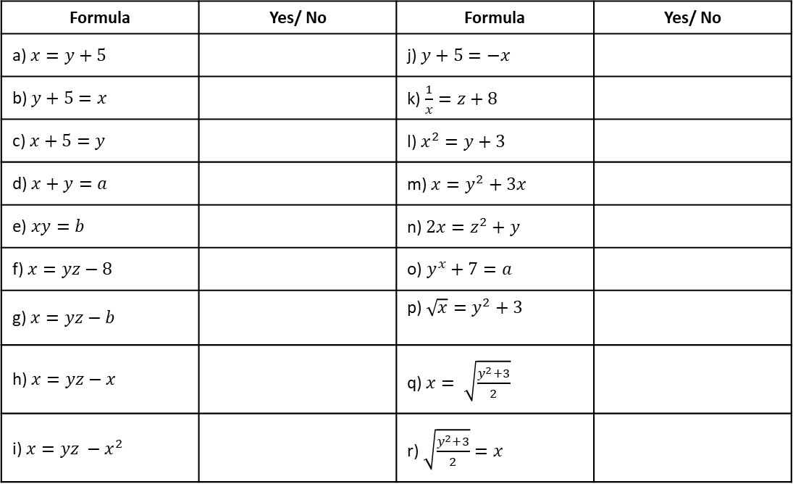

Subtopic 3 – Rearranging Formulae
LEARNING OUTCOME: To be able to rearrange formulae
Objectives:
Keywords:
Equation
Subject
Inverse
Formulae
To be able to rearrange formulae with one-step
To be able to rearrange formulae with two-steps
To be able to rearrange formulae requiring many-steps
Introduction
Rearranging formulae is a lot like solving equations—you still use inverse operations on both sides to
keep things balanced.
The difference is, instead of finding a number, you're working to make a specific variable standalone.
We call this variable the subject of the equation – the single variable that everything else is
equal to. The subject should have no coefficient, constant, power or other function attached to it,
and appear only once in the formula, usually isolated on the left. Examples: Non-examples:
Making a variable the subject can also be described as rewriting the equation to express that variable
in terms of the others.
$$A=πr^{2}$$
$$x=3y+2x$$
$$y=mx+c$$
$$P=2l+2w$$
$5g=3h−$7
$$2n+3=T$$
$$x=\frac{−b±\sqrt{b^{2}−4ac}}{2a}$$
$$m+3=n^{2}+2p$$
$$a^{2}+b^{2}=c^{2}$$
Is $x$ the subject of the formula?
Formula | Yes/ No | Formula | Yes/ No
a) $x=y+5$ |  | j) $y+5=−x$
b) $y+5=x$ |  | k) $\frac{1}{x}=z+8$
c) $x+5=y$ |  | l) $x^{2}=y+3$
d) $x+y=a$ |  | m) $x=y^{2}+3x$
e) $xy=b$ |  | n) $2x=z^{2}+y$
f) $x=yz−8$ |  | o) $y^{x}+7=a$
g) $x=yz−b$ |  | p) $\sqrt{x}=y^{2}+3$
h) $x=yz−x$ |  | q) $x= \sqrt{\frac{y^{2}+3}{2}}$
i) $x=yz −x^{2}$ |  | r) $\sqrt{\frac{y^{2}+3}{2}}=x$
Notes:
Y9 New Bklt 1

Slide 2
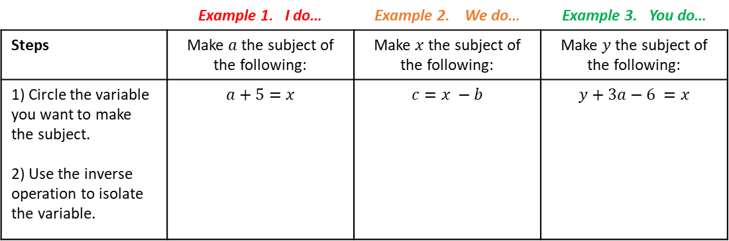
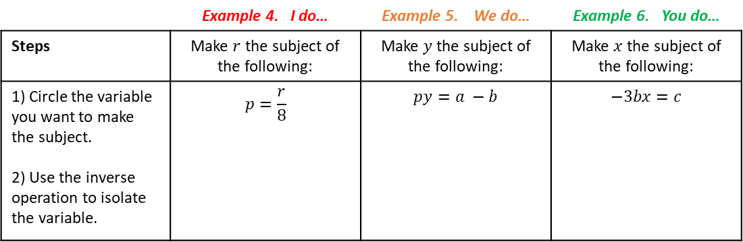
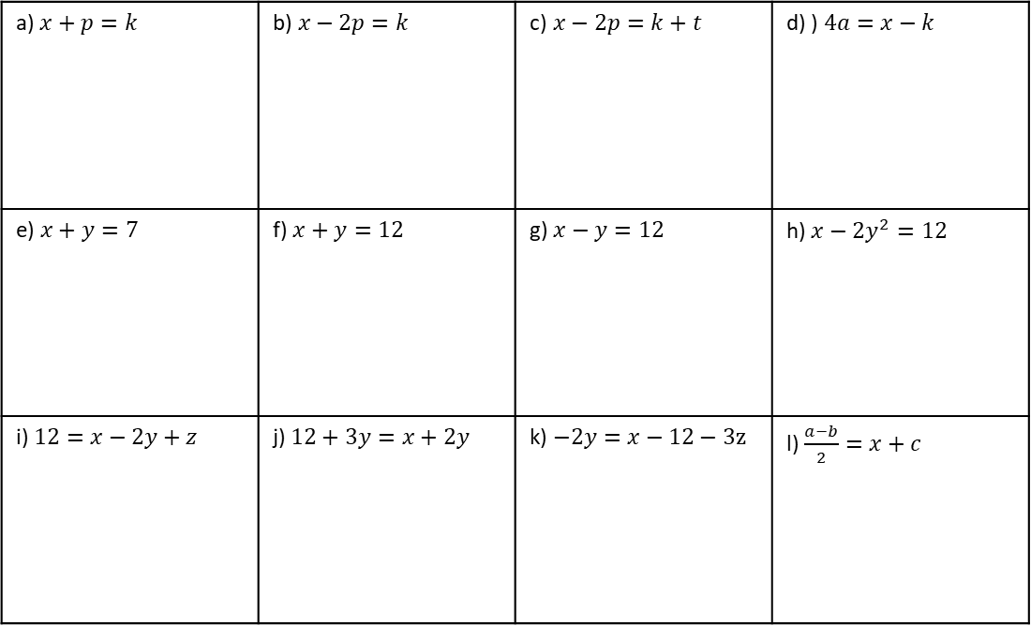
One-Step Rearranging
One-step Rearranging (Addition/ Subtraction)
 | Example 1. I do… | Example 2. We do… | Example 3. You do…
Steps | Make $a$ the subject of the following: | Make $x$ the subject of the following: | Make $y$ the subject of the following:
1) Circle the variable you want to make the subject. 2) Use the inverse operation to isolate the variable. | $$a+5=x$$ | $$c=x −b$$ | $$y+3a−6 =x$$
Independent Practice
Question 1. Make $x$ the subject of the following:
a) $x+p=k$ | b)$x−2p=k$ | c)$x−2p=k+t$ | d) ) $4a=x−k$
e) $x+y=7$ | f) $x+y=12$ | g) $x−y=12$ | h) $x−2y^{2}=12$
i) $12=x−2y+z$ | j) $12+3y=x+2y$ | k) $−2y=x−12−3z$ | l) $\frac{a−b}{2}=x+c$
One-step Rearranging (Multiplication/ Division)
 | Example 4. I do… | Example 5. We do… | Example 6. You do…
Steps | Make $r$ the subject of the following: | Make $y$ the subject of the following: | Make $x$ the subject of the following:
1) Circle the variable you want to make the subject. 2) Use the inverse operation to isolate the variable. | $$p=\frac{r}{8}$$ | $$py=a −b$$ | $$−3bx=c$$
Notes:
Y9 New Bklt 1

Slide 3
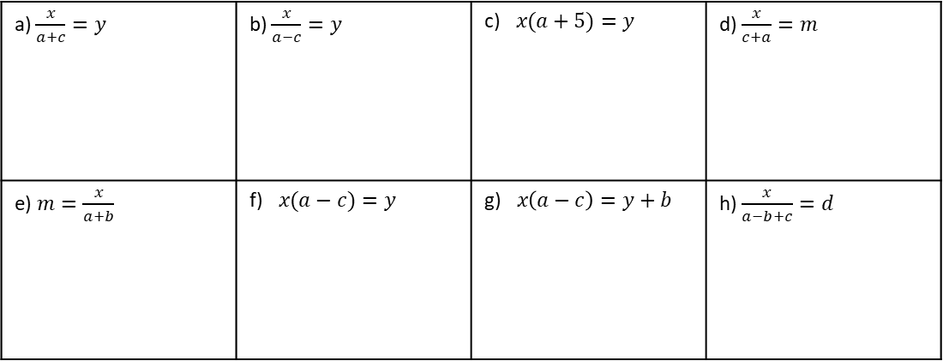
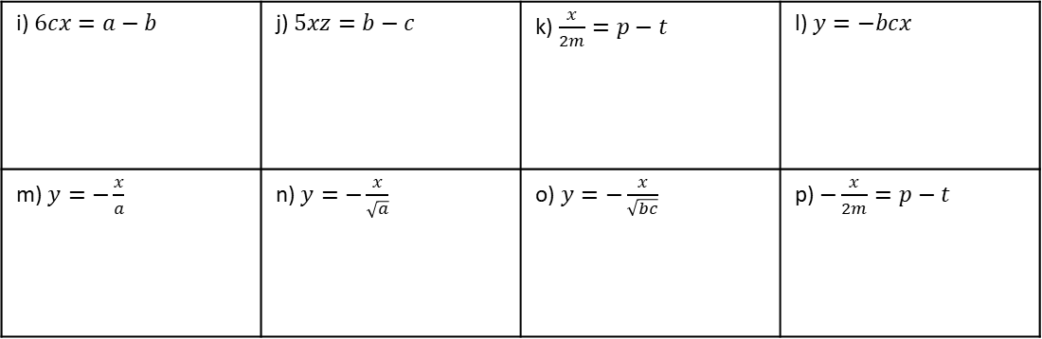
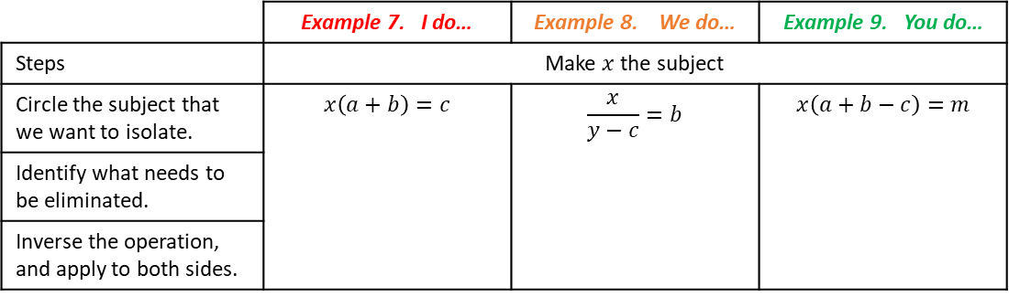
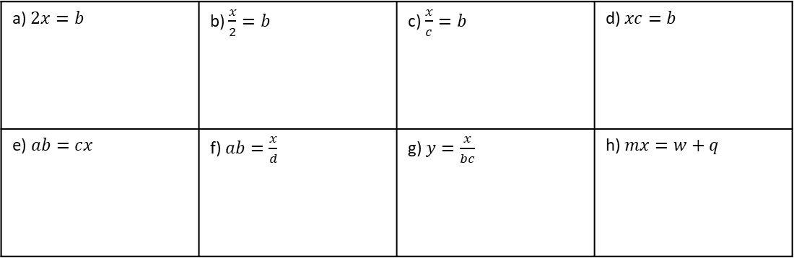
Independent Practice
Question 2. Make $x$ the subject of the following:
a) $2x=b$ | b) $\frac{x}{2}=b$ | c) $\frac{x}{c}=b$ | d) $xc=b$
e) $ab=cx$ | f) $ab=\frac{x}{d}$ | g) $y=\frac{x}{bc}$ | h) $mx=w+q$
i) $6cx=a−b$ | j) $5xz=b−c$ | k) $\frac{x}{2m}=p−t$ | l) $y=−bcx$
m) $y=−\frac{x}{a}$ | n) $y=−\frac{x}{\sqrt{a}}$ | o) $y=−\frac{x}{\sqrt{bc}}$ | p) $−\frac{x}{2m}=p−t$
 | Example 7. I do… | Example 8. We do… | Example 9. You do…
Steps | Make $x$ the subject
Circle the subject that we want to isolate. | $$x\left(a+b\right)=c$$ | $$\frac{x}{y−c}=b$$ | $$x\left(a+b−c\right)=m$$
Identify what needs to be eliminated.
Inverse the operation, and apply to both sides.
Independent Practice
Question 3. Make $x$ the subject of the formulae:
a) $\frac{x}{a+c}=y$ | b) $\frac{x}{a−c}=y$ | c)$x(a+5)=y$ | d) $\frac{x}{c+a}=m$
e) $m=\frac{x}{a+b}$ | f)$x(a−c)=y$ | g)$x\left(a−c\right)=y+b$ | h) $\frac{x}{a−b+c}=d$
Notes:
Y9 New Bklt 1

Slide 4
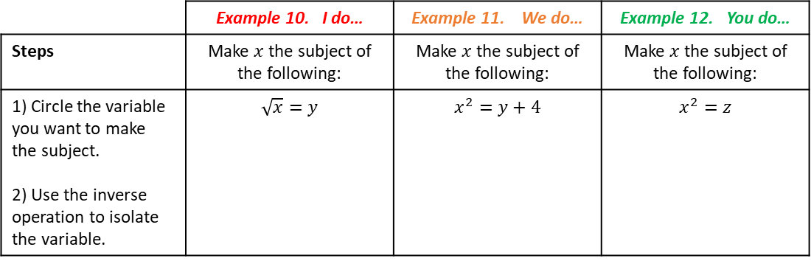
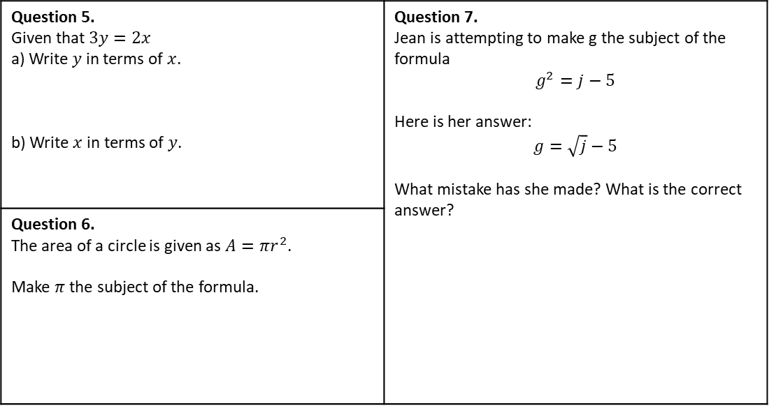
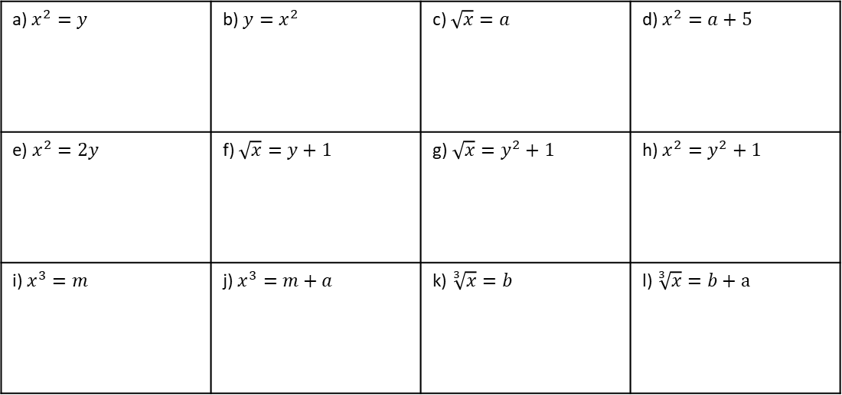
One-step Rearranging (Powers/ Roots)
 | Example 10. I do… | Example 11. We do… | Example 12. You do…
Steps | Make $x$ the subject of the following: | Make $x$ the subject of the following: | Make $x$ the subject of the following:
1) Circle the variable you want to make the subject. 2) Use the inverse operation to isolate the variable. | $$\sqrt{x}=y$$ | $$x^{2}=y+4$$ | $$x^{2}=z$$
Independent Practice
Question 4. Make $x$ the subject of the following:
a) $x^{2}=y$ | b) $y=x^{2}$ | c) $\sqrt{x}=a$ | d) $x^{2}=a+5$
e) $x^{2}=2y$ | f) $\sqrt{x}=y+1$ | g)$\sqrt{x}=y^{2}+1$ | h) $x^{2}=y^{2}+1$
i) $x^{3}=m$ | j) $x^{3}=m+a$ | k) $\sqrt[3]{x}=b$ | l) $\sqrt[3]{x}=b+a$
Mixed Practice
Question 5. Given that $3y=2x$ a) Write $y$ in terms of $x$. b) Write $x$ in terms of $y$. | Question 7. Jean is attempting to make g the subject of the formula $$g^{2}=j−5$$ Here is her answer: $$g=\sqrt{j}−5$$ What mistake has she made? What is the correct answer?
Question 6. The area of a circle is given as $A=πr^{2}$. Make $π$ the subject of the formula.
4

Slide 5
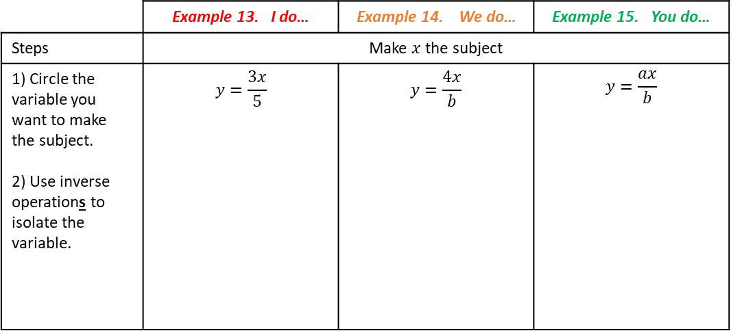
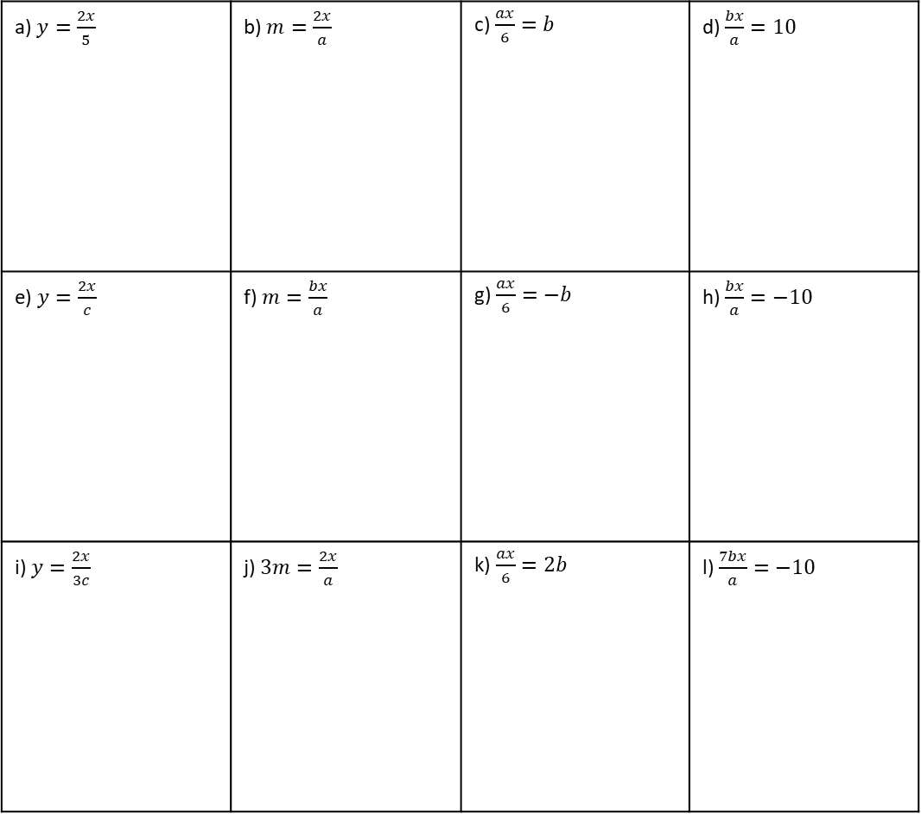
Two-step Rearranging (multiplication and division)
 | Example 13. I do… | Example 14. We do… | Example 15. You do…
Steps | Make $x$ the subject
1) Circle the variable you want to make the subject. 2) Use inverse operations to isolate the variable. | $$y=\frac{3x}{5}$$ | $$y=\frac{4x}{b}$$ | $$y=\frac{ax}{b}$$
Independent Practice
Question 8. Make $x$ the subject of the following:
a) $y=\frac{2x}{5}$ | b) $m=\frac{2x}{a}$ | c) $\frac{ax}{6}=b$ | d) $\frac{bx}{a}=10$
e) $y=\frac{2x}{c}$ | f) $m=\frac{bx}{a}$ | g) $\frac{ax}{6}=−b$ | h) $\frac{bx}{a}=−10$
i) $y=\frac{2x}{3c}$ | j) $3m=\frac{2x}{a}$ | k) $\frac{ax}{6}=2b$ | l) $\frac{7bx}{a}=−10$
Notes:
Old Y10

Slide 6
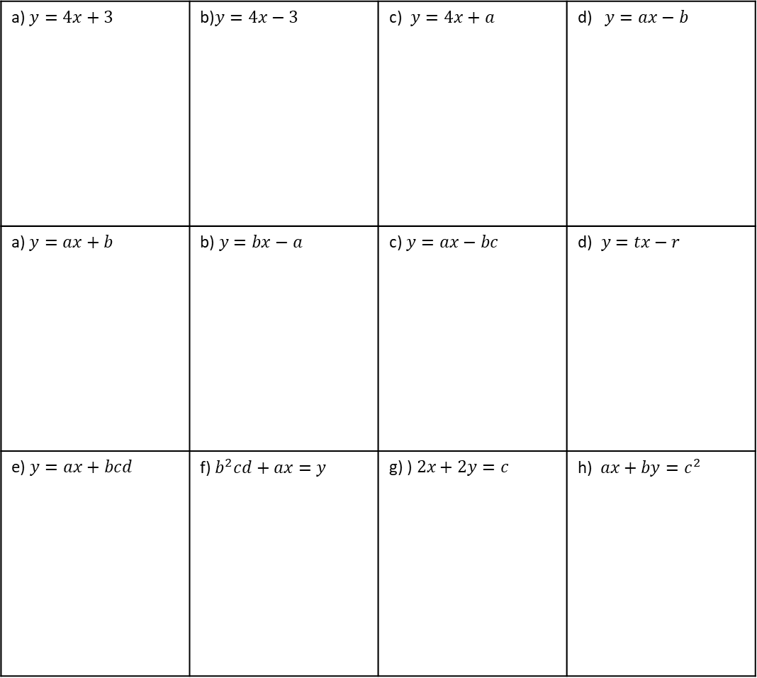
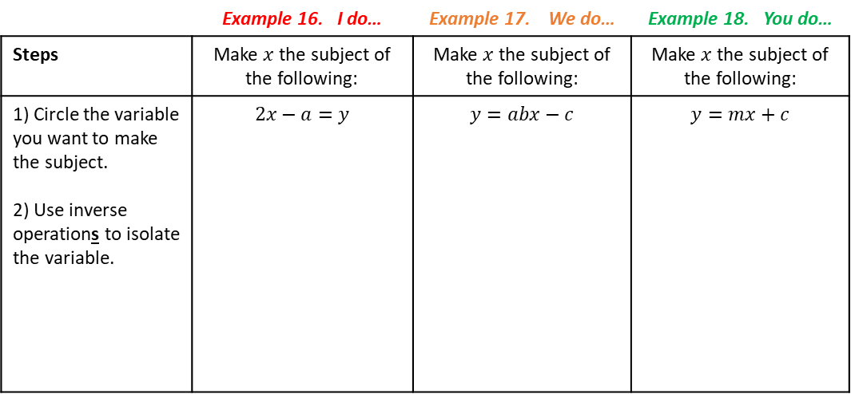
Two-Step Rearranging
Two-step Rearranging (addition/ subtraction with division)
 | Example 16. I do… | Example 17. We do… | Example 18. You do…
Steps | Make $x$ the subject of the following: | Make $x$ the subject of the following: | Make $x$ the subject of the following:
1) Circle the variable you want to make the subject. 2) Use inverse operations to isolate the variable. | $$2x−a=y$$ | $$y=abx−c$$ | $$y=mx+c$$
Independent Practice
Question 9. Make $x$ the subject of the following:
a) $y=4x+3$ | b)$y=4x−3$ | c) $y=4x+a$ | d) $y=ax−b$
a) $y=ax+b$ | b)$y=bx−a$ | c) $y=ax−bc$ | d)$y=tx−r$
e) $y=ax+bcd$ | f) $b^{2}cd+ax=y$ | g) )$2x+2y=c$ | h) $ax+by=c^{2}$
6
Notes:
Y9 New Bklt 1

Slide 7
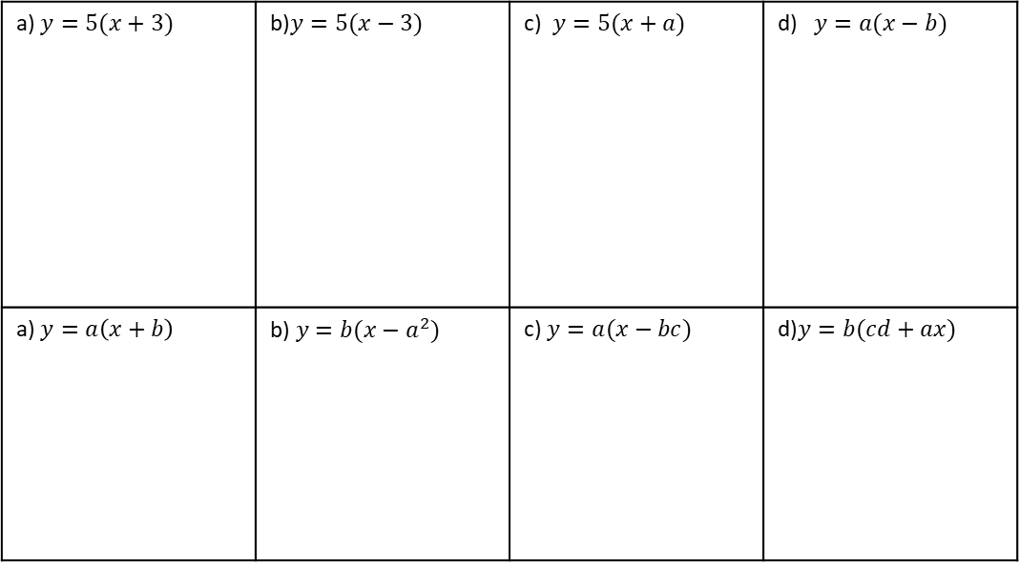
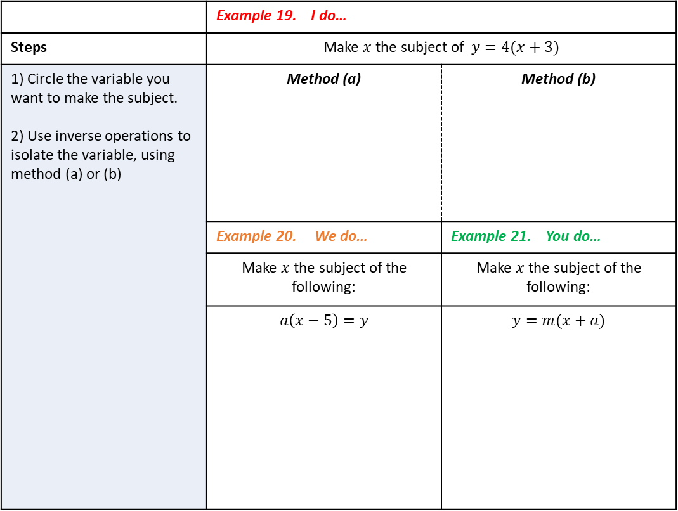
Where there are brackets in the formula, there are two approaches to change the subject:
(a) Expand the brackets and rearrange as previously
(b) Consider the multiplication of the bracket as an operation to be ‘undone’ first.
 | Example 19. I do…
Steps | Make $x$ the subject of $y=4(x+3)$
1) Circle the variable you want to make the subject. 2) Use inverse operations to isolate the variable, using method (a) or (b) | Method (a) | Method (b)
 | Example 20. We do… | Example 21. You do…
 | Make $x$ the subject of the following: | Make $x$ the subject of the following:
 | $$a\left(x−5\right)=y$$ | $$y=m(x+a)$$
Independent Practice
Question 10. Make $x$ the subject of the following:
a) $y=5(x+3)$ | b)$y=5(x−3)$ | c) $y=5(x+a)$ | d) $y=a(x−b)$
a) $y=a\left(x+b\right)$ | b)$y=b(x−a^{2})$ | c) $y=a(x−bc)$ | d)$y=b(cd+ax)$
7
Notes:
Y9 New Bklt 1

Slide 8
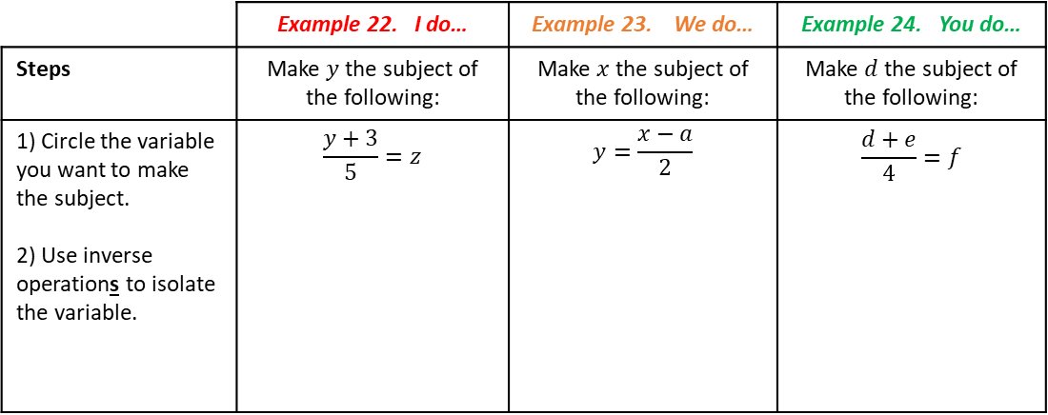
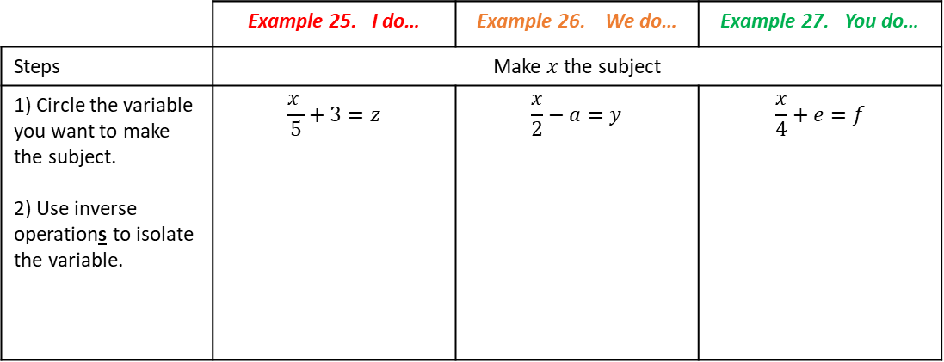
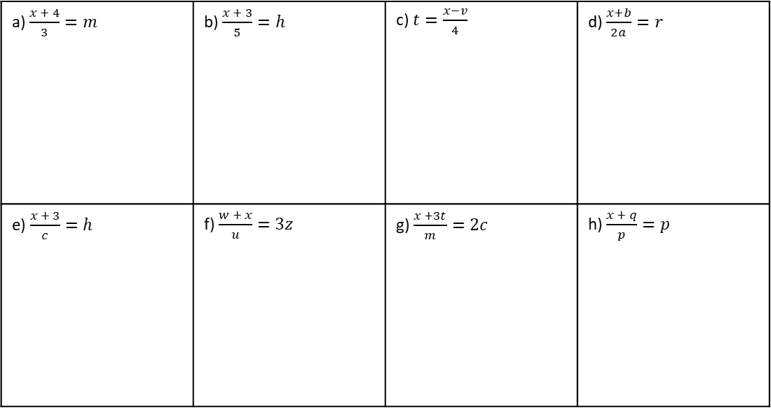
Two-step Rearranging (addition/ subtraction with multiplication)
Carefully consider the order of operations for divisions across single and multiple terms.
 | Example 22. I do… | Example 23. We do… | Example 24. You do…
Steps | Make $y$ the subject of the following: | Make $x$the subject of the following: | Make $d$ the subject of the following:
1) Circle the variable you want to make the subject. 2) Use inverse operations to isolate the variable. | $$\frac{y+3}{5}=z$$ | $$y=\frac{x−a}{2}$$ | $$\frac{d+e}{4}=f$$
Independent Practice
Question 11. Make $x$ the subject of the following:
a) $\frac{x + 4}{3}=m$ | b) $\frac{x + 3}{5}=h$ | c) $t=\frac{x−v}{4}$ | d) $\frac{x+b}{2a}=r$
e) $\frac{x + 3}{c}=h$ | f) $\frac{w + x}{u}=3z$ | g) $\frac{x +3t}{m}=2c$ | h) $\frac{x + q}{p}=p$
 | Example 25. I do… | Example 26. We do… | Example 27. You do…
Steps | Make $x$ the subject
1) Circle the variable you want to make the subject. 2) Use inverse operations to isolate the variable. | $$\frac{x }{5}+3=z$$ | $$\frac{x}{2}−a=y$$ | $$\frac{x}{4}+e=f$$
Notes:
Y9 New Bklt 1

Slide 9


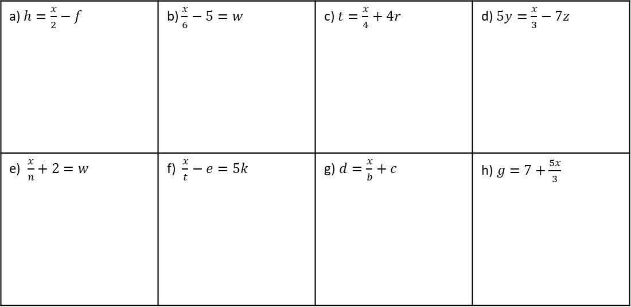
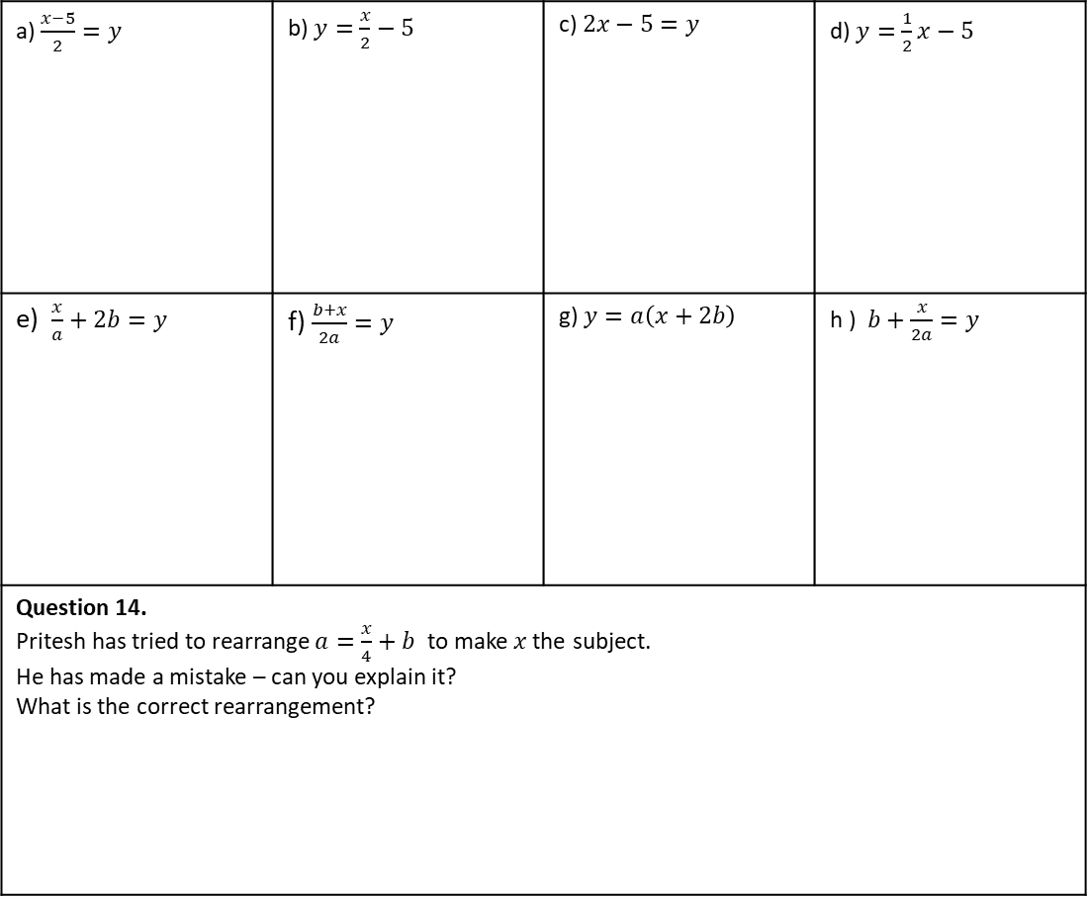


Independent Practice
Question 12. Make $x$ the subject of the following:
a) $h=\frac{x}{2}−f$ | b) $\frac{x}{6}−5=w$ | c) $t=\frac{x}{4}+4r$ | d) $5y=\frac{x}{3}−7z$
e) $\frac{x}{n}+2=w$ | f) $\frac{x}{t}−e=5k$ | g)$d=\frac{x}{b}+c$ | h)$g=7+\frac{5x}{3}$
Mixed Practice
Question 13. Make $x$ the subject
a) $\frac{x−5}{2}=y$ | b) $y=\frac{x}{2}−5$ | c) $2x−5=y$ | d) $y=\frac{1}{2}x−5$
e) $\frac{x}{a}+2b=y$ | f) $\frac{b+x}{2a}=y$ | g) $y=a\left(x+2b\right)$ | h ) $b+\frac{x}{2a}=y$
Question 14. Pritesh has tried to rearrange $a=\frac{x}{4}+b$ to make$x$the subject. He has made a mistake – can you explain it? What is the correct rearrangement?
$$a=\frac{x}{4}+b$$
$4a=x+b$
$4a−b=x$
Notes:
Y9 New Bklt 1

Slide 10
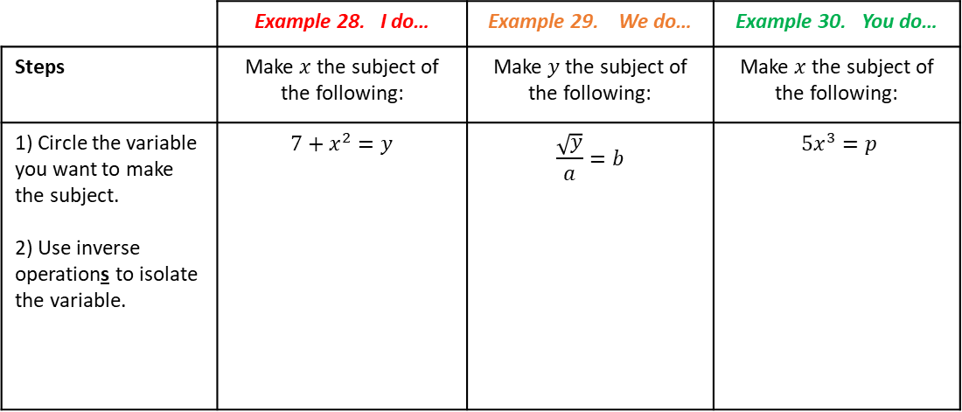
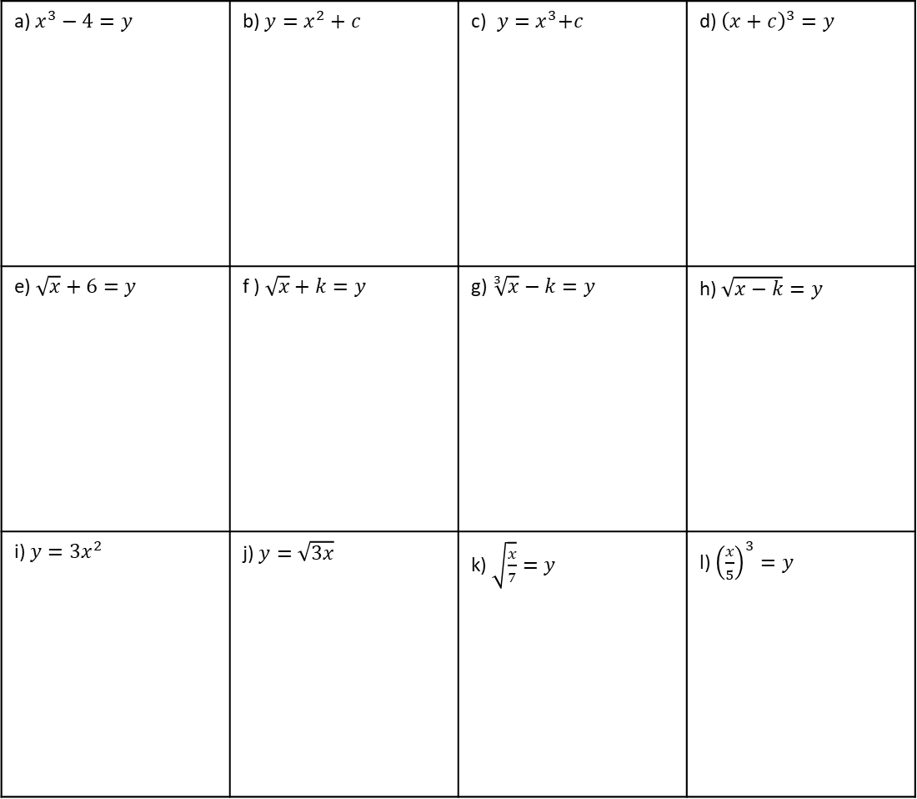
Two-step Rearranging with Powers and Roots
 | Example 28. I do… | Example 29. We do… | Example 30. You do…
Steps | Make $x$ the subject of the following: | Make $y$ the subject of the following: | Make $x$ the subject of the following:
1) Circle the variable you want to make the subject. 2) Use inverse operations to isolate the variable. | $$7+x^{2}=y$$ | $$\frac{\sqrt{y}}{a}=b$$ | $5x^{3}=p$
Independent Practice
Question 15. Make $x$ the subject of the following:
a) $x^{3}−4=y$ | b) $y=x^{2}+c$ | c)${ y=x}^{3}+c$ | d) ${\left(x+c\right)}^{3}=y$
e)$\sqrt{x}+6=y$ | f )$\sqrt{x}+k=y$ | g) $\sqrt[3]{x}−k=y$ | h) $\sqrt{x−k}=y$
i) $y=3x^{2}$ | j) $y=\sqrt{3x}$ | k) $\sqrt{\frac{x}{7}}=y$ | l) ${\left(\frac{x}{5}\right)}^{3}=y$
Notes:
Y9 New Bklt 1

Slide 11
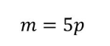

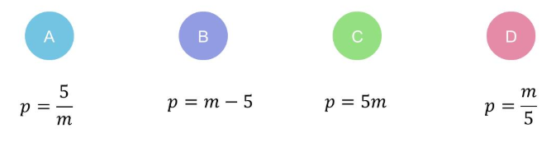
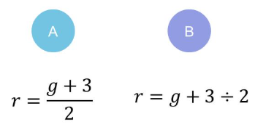
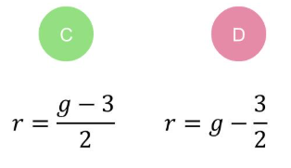
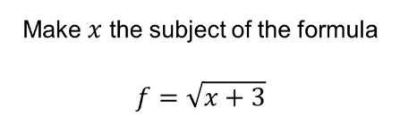
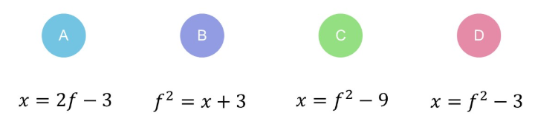
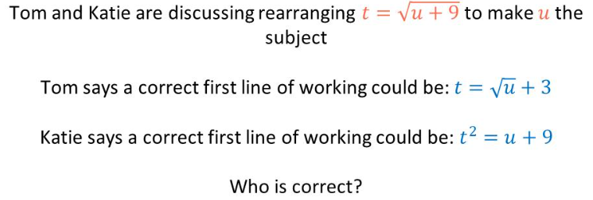
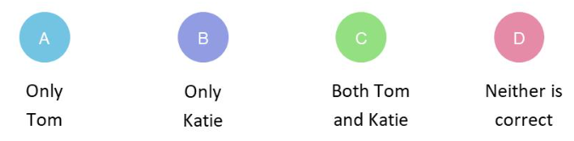
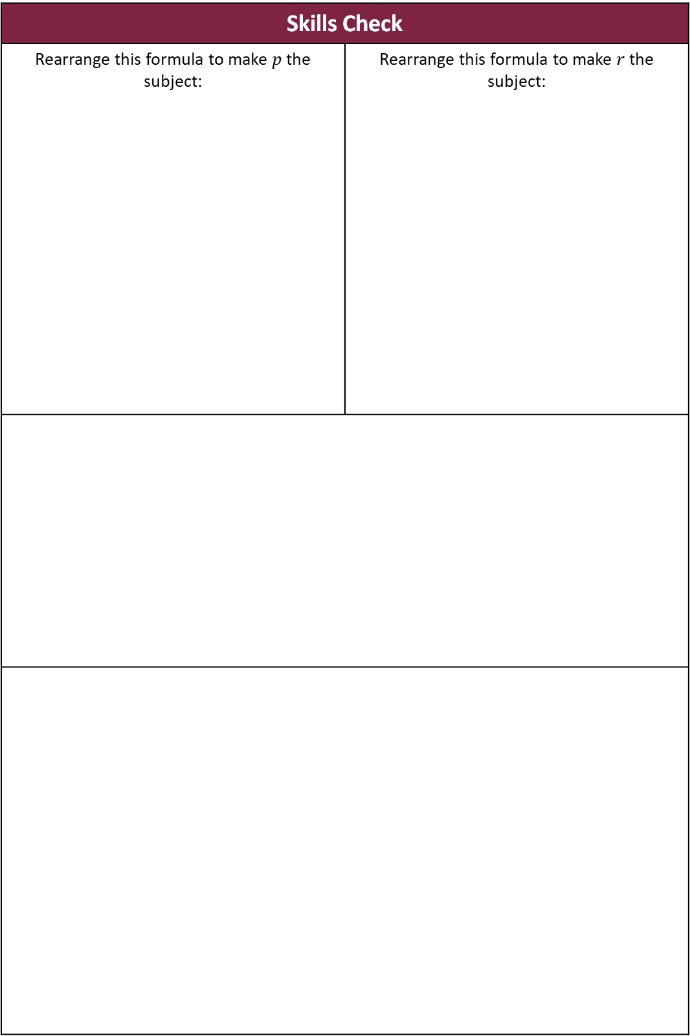
Skills Check
Rearrange this formula to make $p$ the subject: | Rearrange this formula to make $r$ the subject:
11

Slide 12
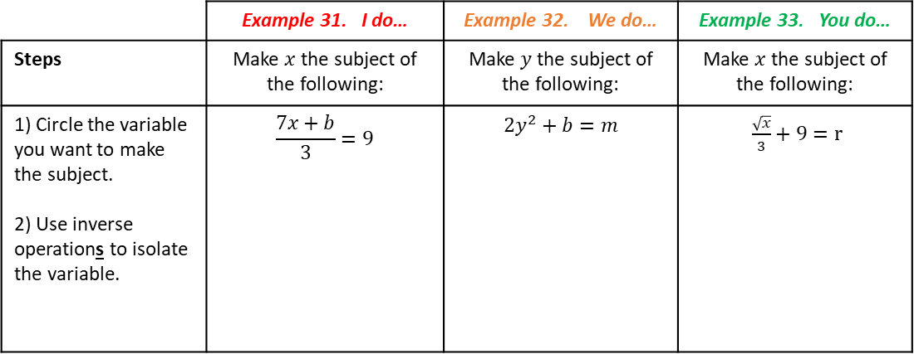
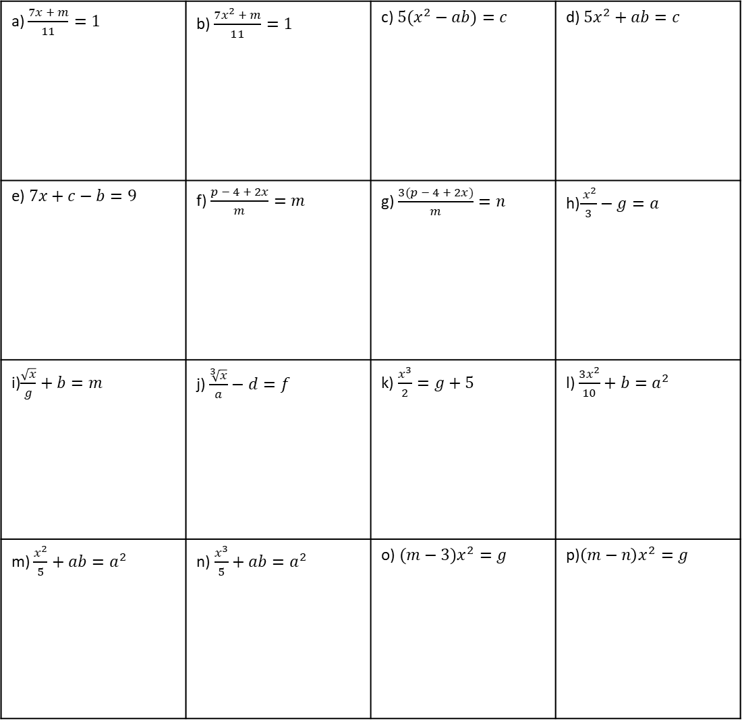
Multi-step Rearranging - CHALLENGE
 | Example 31. I do… | Example 32. We do… | Example 33. You do…
Steps | Make $x$ the subject of the following: | Make $y$ the subject of the following: | Make $x$ the subject of the following:
1) Circle the variable you want to make the subject. 2) Use inverse operations to isolate the variable. | $$\frac{7x+b}{3}=9$$ | $$2y^{2}+b=m$$ | $\frac{\sqrt{x}}{3}+9=r$
Independent Practice
Question 16. Make $x$ the subject of the following:
a) $\frac{7x + m}{11}=1$ | b) $\frac{7x^{2} + m}{11}=1$ | c) $5(x^{2}−ab)=c$ | d) $5x^{2}+ab=c$
e)$7x+c−b=9$ | f) $\frac{p − 4 + 2x}{m}=m$ | g) $\frac{3(p − 4 + 2x)}{m}=n$ | h)$\frac{ x^{2}}{3}−g=a$
i)$\frac{\sqrt{x}}{g}+b=m$ | j) $\frac{\sqrt[3]{x}}{a}−d=f$ | k) $\frac{x^{3}}{2}=g+5$ | l) $\frac{3x^{2}}{10}+b=a^{2}$
m) $\frac{x^{2}}{5}+ab=a^{2}$ | n)$\frac{x^{3}}{5}+ab=a^{2}$ | o) $(m−3)x^{2}=g$ | p)$\left(m−n\right)x^{2}=g$
Notes:
Y9 New Bklt 1

Slide 13
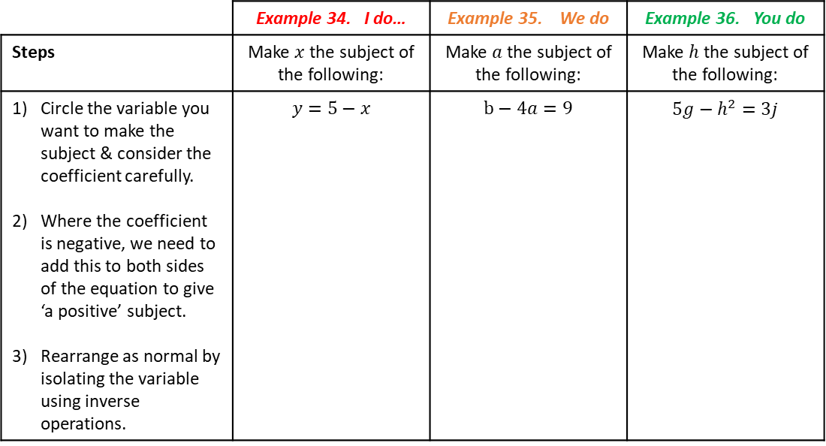
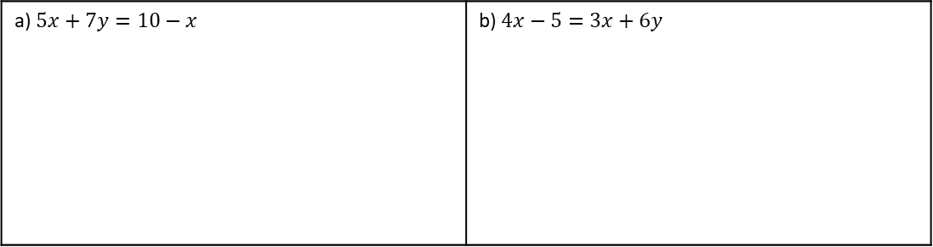
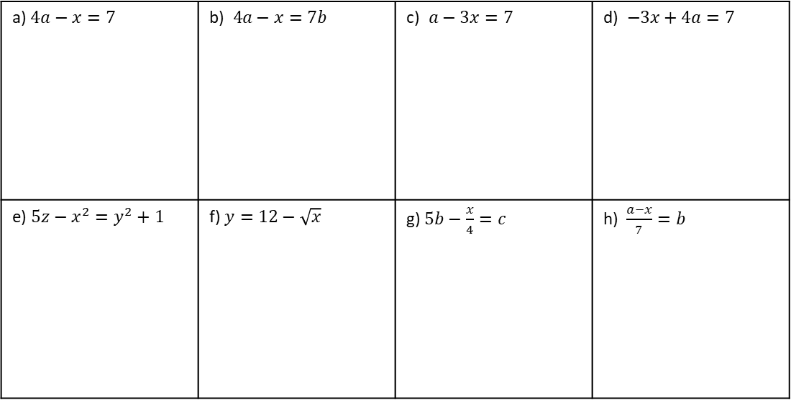
Multi-Step Rearranging - Formulae with a Negative Coefficient of the Subject
 | Example 34. I do… | Example 35. We do | Example 36. You do
Steps | Make $x$ the subject of the following: | Make $a$ the subject of the following: | Make $h$ the subject of the following:
Circle the variable you want to make the subject & consider the coefficient carefully. Where the coefficient is negative, we need to add this to both sides of the equation to give ‘a positive’ subject. Rearrange as normal by isolating the variable using inverse operations. | $$y=5−x$$ | $$b−4a=9$$ | $$5g−h^{2}=3j$$
Independent Practice
Question 17. Make $x$ the subject of the following:
a) $4a−x=7$ | b)$4a−x=7b$ | c)$a−3x=7$ | d)$−3x+4a=7$
e) $5z−x^{2}=y^{2}+1$ | f) $y=12−\sqrt{x}$ | g) $5b−\frac{x}{4}=c$ | h) $\frac{a−x}{7}=b$
Challenge
Question 18. Make $x$ the subject of the following:
a) $5x+7y=10−x$ | b) $4x−5=3x+6y$
13

Slide 14
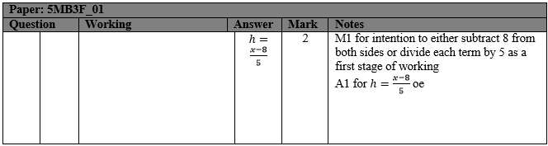
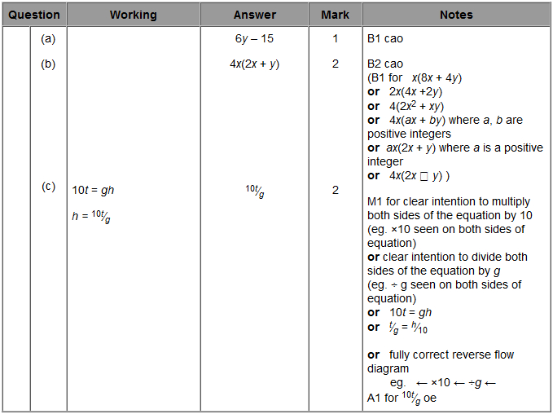
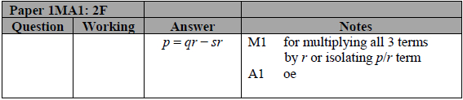
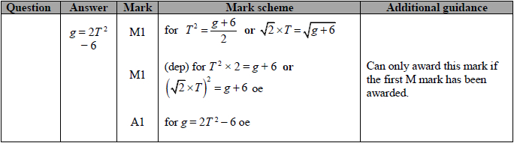


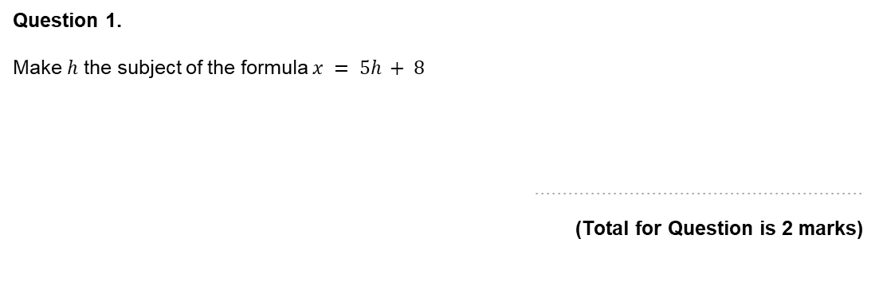

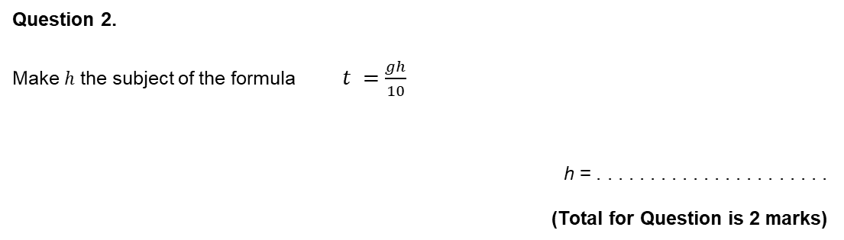
Exam Questions
Question 1.
Make $h$ the subject of the formula $x = 5h + 8$
...........................................................
(Total for Question is 2 marks)
Question 2.
Make $h$ the subject of the formula $t =\frac{gh}{10}$
h = . . . . . . . . . . . . . . . . . . . . . .
(Total for Question is 2 marks)
Question 3.
Make $p$ the subject of this formula.
...........................................................
(Total for question = 2 marks)
$$q=\frac{p}{r}+s$$
Question 4.
Make g the subject of the formula
$$T=\sqrt{\frac{g+6}{2}}$$
...........................................................
(Total for question = 3 marks)
14

Slide 15
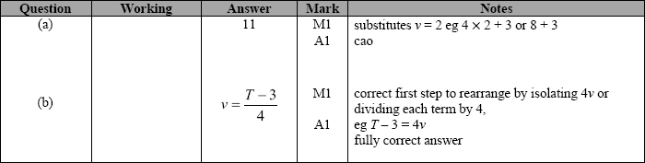
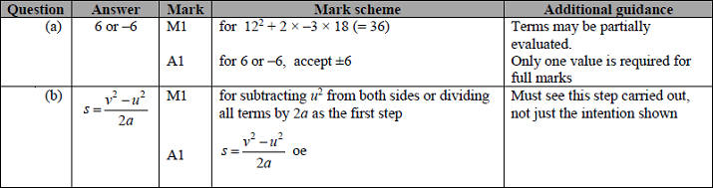


Question 5.
$$T = 4v + 3$$
(a) Work out the value of $T$ when $v = 2$
T = ...........................................................
(2)
(b) Make $v$ the subject of the formula $T = 4v + 3$
...........................................................
(2)
(Total for question = 4 marks)
Question 6.
$$v2 = u2 + 2as$$
$$u = 12 a = –3 s = 18$$
(a) Work out a value of $v.$
...........................................................
(2)
(b) Make $s$ the subject of $v2 = u2 + 2as$
......................................................................................................................
(2)
(Total for question = 4 marks)
15

